Slide 1
Special Topics in CS

Slide 2
Computer Science vs. Management Information Science
Computer science is programming intensive
Involves
  system architecture
  software engineering
  application programming
  hardware
  theory
Information Technology is organization related applications
  business related
  organizational automation

Slide 3
Careers – Graduating Bachelors
Software Development
Software Engineering
Database Administration
Database Programming
Internet Engineering
Web Development
Systems Administration
Network Administration
Information Technology

Slide 4
Job Prospects in CS
Dot-com bust did not reduce the demand
Outsourcing is mainly in lower level help desk jobs. More jobs are being created
Job prospects are very bright
  2004-2014, 71% of new jobs in science and engineering were computer specialists
  59% of new jobs plus net replacements

Slide 5
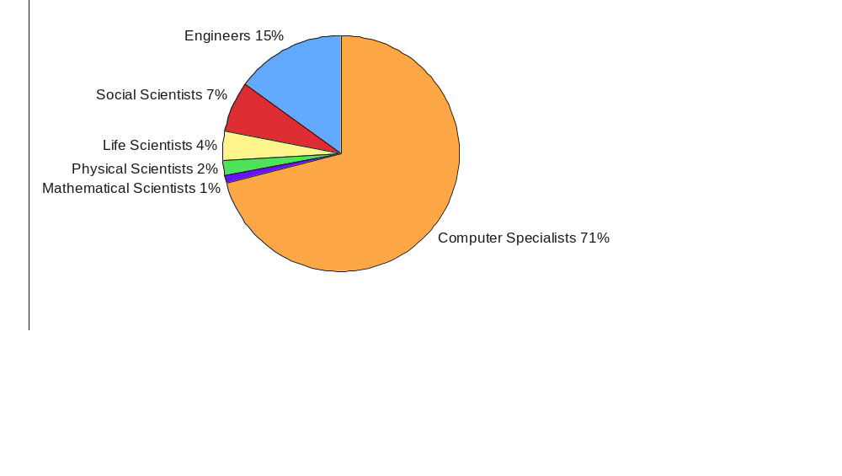
New Jobs – Labor Department
US Bureau of Labor Statistics, November 2015

Slide 6
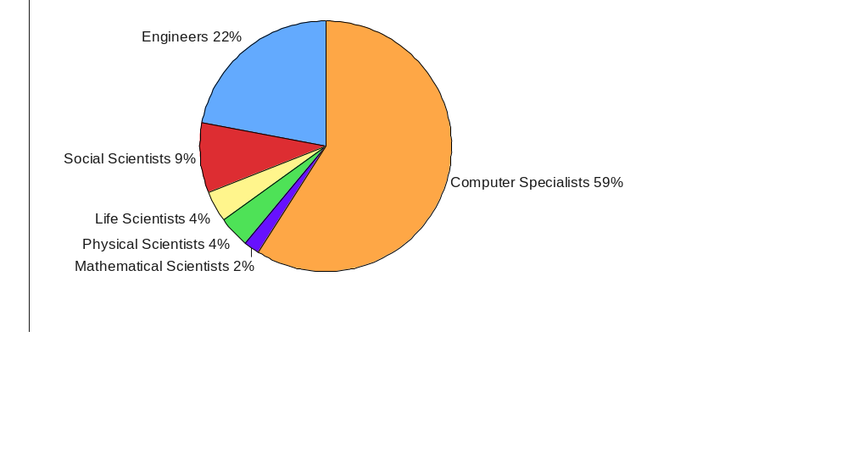
Job Prospects ( New + Replacement )‏
59%
US Bureau of Labor Statistics, November 2015

Slide 7
Job Demand & Growth
Computer Science graduates are in top 5 of demand market (CNN)‏
U.S. Department of Labor – Projected to be top 5 fastest growing occupations (46% over next 10 years)‏
CNN Money says “Software Engineer” is best job in US
2700 Software development jobs are currently unfilled in Northeast Ohio (Northeast Ohio Workforce Report)‏
Notes:
http://www.bls.gov/oco/ocos267.htm
http://www.internetweek.com/story/showArticle.jhtml?articleID=160900829
"Computer science and IT-related majors will see an increase in opportunities for the first time since the collapse of the dot.com sector," stated Dr. Philip Gardner, director of the Collegiate Employment Research Institute (CERI) at Michigan State University. "The information services sector is still facing hard times with overcapacity in the telecommunications sector and limited growth in on-line businesses."
www.naceweb.org

Slide 8
Focus
Integration of theory and system perspective of computer and software development
Solid emphasis on software development
Provide solid foundation essential to keep pace with rapid change in evolving field
Keep up with the changing market demands
Incorporation of new emerging areas through
  senior level elective optional courses
  project oriented courses
  internships in industries

Slide 9
Project Areas
Artificial Intelligence
Bioinformatics and application to biotechnology
Cluster computing
Computer graphics and game Design
Database and data mining
Image processing
Internet application
Multimedia and programming languages
Networking, Internet Engineering, and distributed sensor networks
Software engineering
Parallel & distributed systems,
Visualization
Web based education

